Slide 1

IS480 Acceptance
Stepwise

Slide 2
Agenda
Introduction of Team and Sponsor
Background and Problem
Market Research
Solution and Description
Project Administration
Demonstration
Risks & Limitations
Conclusion

Slide 3
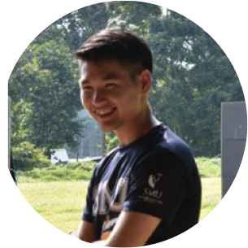
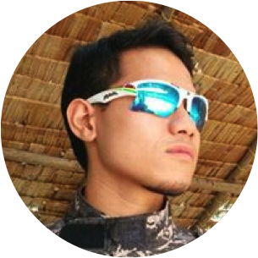

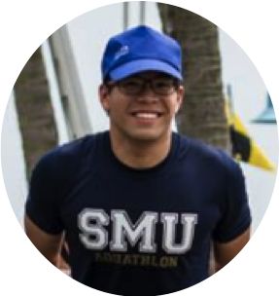
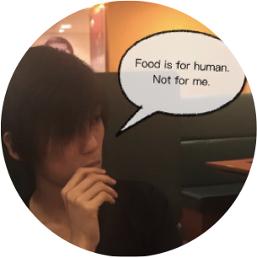

The Team
Christopher
Shahid
Zheng Yuan
Aloysius
Jason
Friedemann

Slide 4
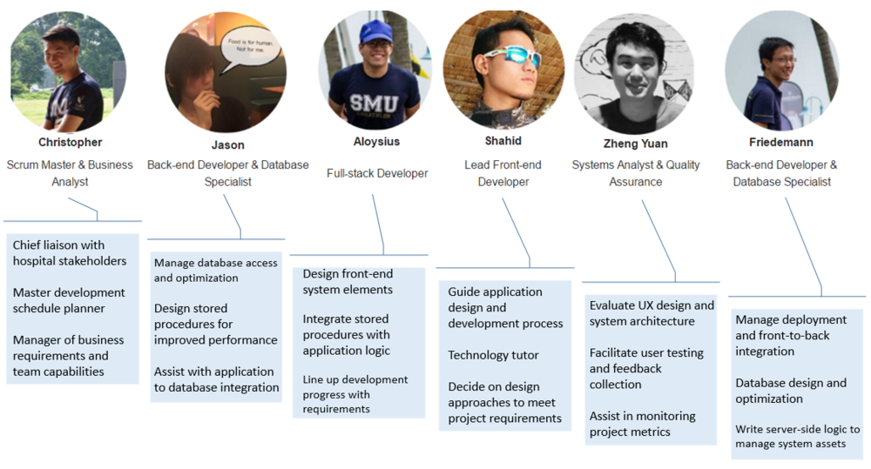
The Team
Notes:
Chris – PM, BA
Jason Friedemann – backend & database
Aloy and Shabid – front end
Zheng Yuan – QA, SA

Slide 5

Sponsor and Supervisor
Mr Damien Tong Chee Kin,
HR Director
Mr Edy Chandra,
System Analyst
Dr Jocelyn Koh,
Infection Control Team
Ms Sarah Lim,
Infection Control Team
Notes:
Mr Damien & Mr Edy (Project admin & IT side)
Dr Jocelyn, Ms Sarah (ICT, business process & requirements)
Hospital information: 300+ beds, 600+ staff
Non-profit Community Hospital.
Non-profit: many heavily subsidized patients (by govt or sponsors)
Community Hospital: step-down care after acute hospital. Patients spend 2 weeks -3 months of care. Eg. After a stroke. Focus on Rehab and promote independence so they can go home
Share facilities with others like TTSH, NKF

Slide 6
Project Introduction
Known to the Hospital as a ‘Triage System’.
The Triage System is deployed:
During states of medical emergency
Objectives:
Replace the old system
Reduce reliance on staff when system is implemented
Create a more accurate contact tracing list
Notes:
AMKTHKH currently possesses a legacy system developed for Visitor Logging known as the “Triage System” which is not currently in use due system incompatibility. The hospital wants to replace this system with one which is more robust and keeps manual tasks to a minimum.
Because it is hospital, susceptible to spread of diseases. Lots of human traffic. Especially for highly contagious diseases.
Deployed in States of Emergencies: Eg. SAR, to provide a contact list of people who have come in contact with infectious visitors or patients.
Objectives:
Replace the old system – various reasons – incompatible hardware, different technologies (VB). (10 years ago)
Reduce reliance on staff for visitor registration
Create a more accurate contact tracing list

Slide 7
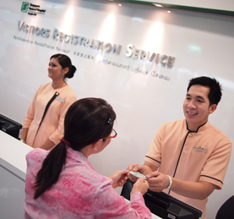
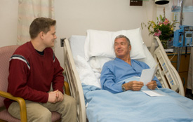


Sponsor & Stakeholder Characteristics
Visitors
Nurses
(Counter Staff)
Admin
Infection Control Team
Notes:
4 target user groups.

Slide 8








Storyboard
5 Nov
6 Nov
Notes:
Now is avian flu, very serious. MOH raise alert level to red. Triage at hospital activated.
Jeremy: On 5 Nov, visit friend, Aaron, who recovering from stroke. At the hospital entrance, take temperature, report to counter to sign in. Take pass and perform visit. Drop pass and exit
Infection Control Team Member: Aaron on 6Nov diagnosed with avian flu. ICT member need to contact trace to see who come into contact with Aaron for the past 2 days.
MIS passes excel sheet of visitors to ICT team
ICT Send SMS / call to close contacts.

Slide 9
Problem Statement
There is a need to accurately determine a list of people who have had close contact with a patient and might have been transmitted the disease.
Notes:
Solution’s needs
Visitor particulars logging
Locations within hospital
Contact Tracing Report
Mobile. Easily set up, dismantled, replace parts of the system hassle free.

Slide 10
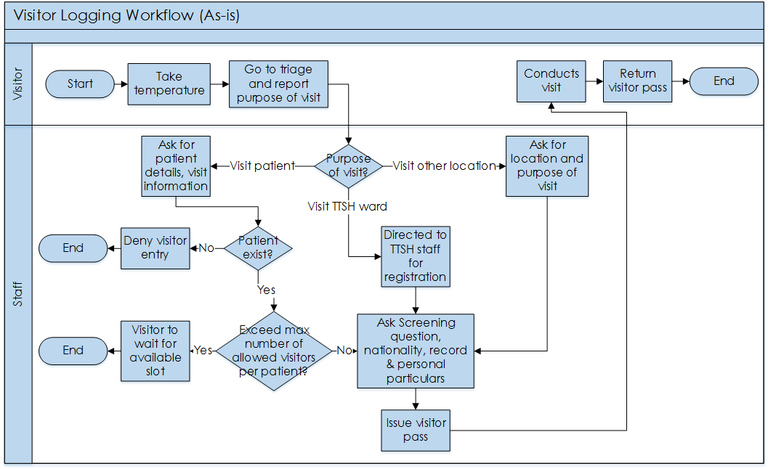
As-is Business Process
Notes:
What they currently have: there are inadaquacies
What the problem with the
AS-IS is: poor data quality. Only have entry data
There will be variations / movements will differ from what they reported. Did they really go to the ward? What the visitor went to other places as well?
If visitor gets infected, they can at least find out his locations within the hospital.
Not able to meet all the Solution’s needs
Visitor particulars logging
Locations within hospital
Contact Tracing Report
Easily set up, dismantled, replace parts of the system hassle free.
Problem statement: Why is the internal scanning required??? Not just in out??
Contact tracing! Explain why it is a problem in the context of the previous selection, sponsor characteristics
What is needed the fulfil contact tracing needs: knowledge of visitor movement by time

Slide 11
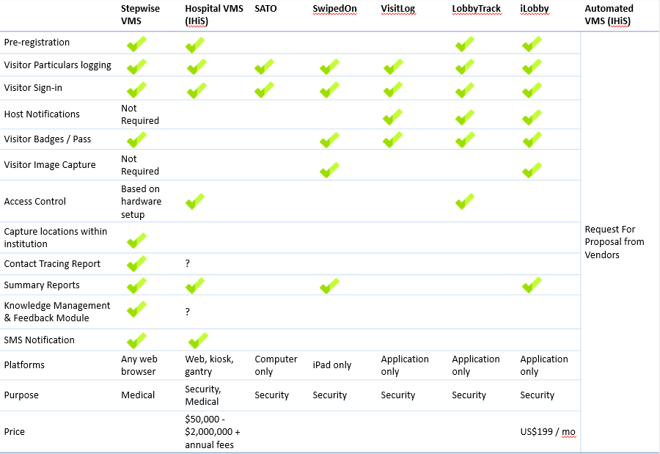
Market Comparison
Notes:
What is available on the market:
2 categories.
Commercial off the shelf
Complete solution software suite. (hospital VMS)
All meet the first requirement: visitor particulars logging
Most do not meet the second requirement: Locations within hospital. ‘front door’ security.
Do not meet third requirement: contact tracing report. -- As simple as a query, but lack of accurate data points within hospital. Cannot use the data for further analysis
Purpose of those systems: security. Unexpected visitor
Complete solution:
Also include many other modules like HRMS, patient management, patient tracking etc.
Not able to just buy 1 module. Inappropriate to change entire info systems just for contact tracing needs. Inappropriate due to price. 50k – 2mil.
Most need to purchase more hardware / infrastructure. Tablets, gantry
Not appropriate for Community Hospital as it is ‘overkill’. Hospital’s needs are contact tracing as priority.
IHiS (manages integrated healthcare information systems in SG) – Request for proposal from vendors AVMS

Slide 12
Solution Statement
Visitor registers
Sign in at counter
Track within the hospital by scanning-in
Notes:
Summary of solution

Slide 13
Solution Statement
Register, sign in, track!

Slide 14
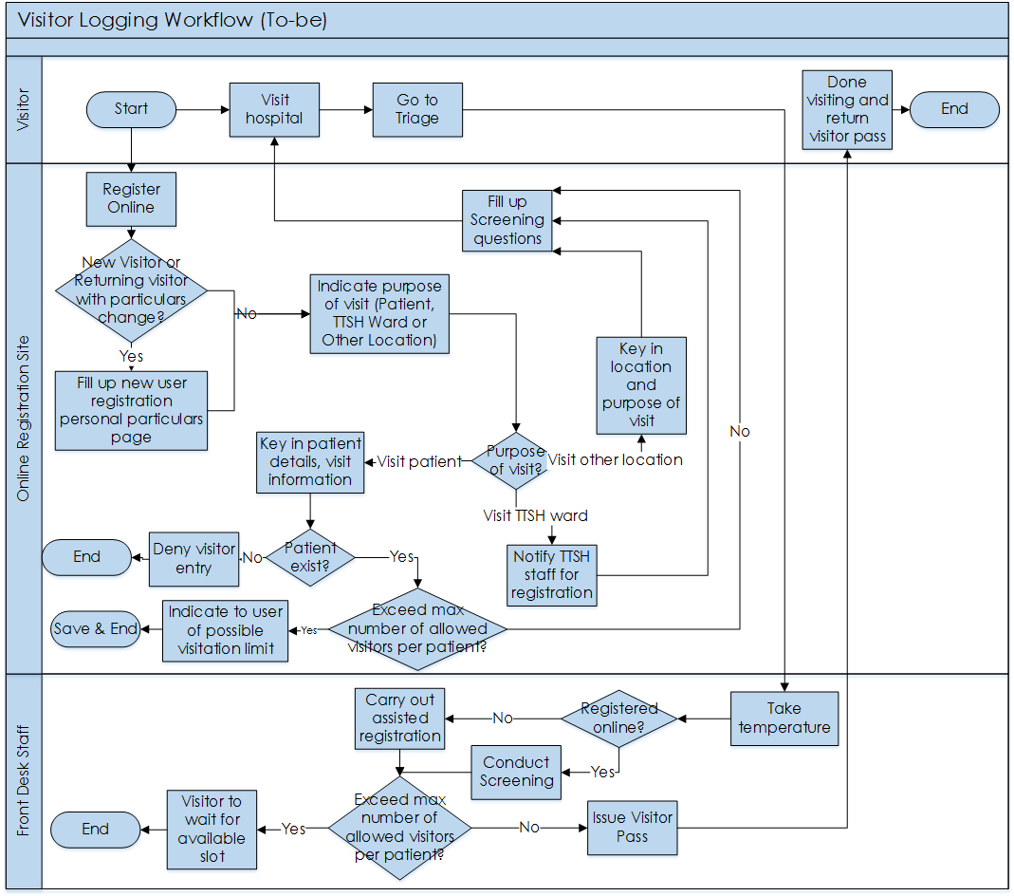
To-be Business Process
Notes:
Explain how this to-be process overcomes the pitfalls of the AS-IS, and the off-the-shelf solutions
Online registration available
Staff need not manually enter. They only need to help those who don’t know how to use computers. Focus of staff changed. Keying in data to ensuring data are accurate.
System will handle the registration validations
Tracking within and at exit

Slide 15
Solution
PROBLEM
SOLUTION
Visitor Particulars Logging
Online & Assisted Patient Registration
Track visitor’s locations within hospital
Check-in at Entry, Exit and intermediate checkpoints
Contact Tracing
Contact Tracing Report
Ease of implementation & flexible scalability
Highly mobile hardware
Notes:
Visitor particulars logging
Locations within hospital
Contact Tracing Report
Easily set up, dismantled, replace parts of the system hassle free. One day don’t have, next day have
Reduce reliance on staff when system is implemented
Create a more accurate contact tracing list

Slide 16
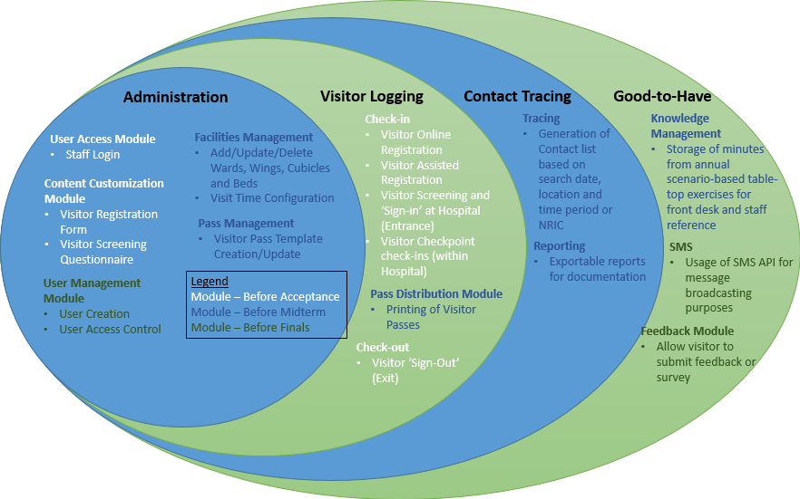
Scope
Notes:
White: Core functions for the system to work
Blue: Support functions (admin, reports) Modules on top of the core functions
Green: add-ons (other then user management)

Slide 17
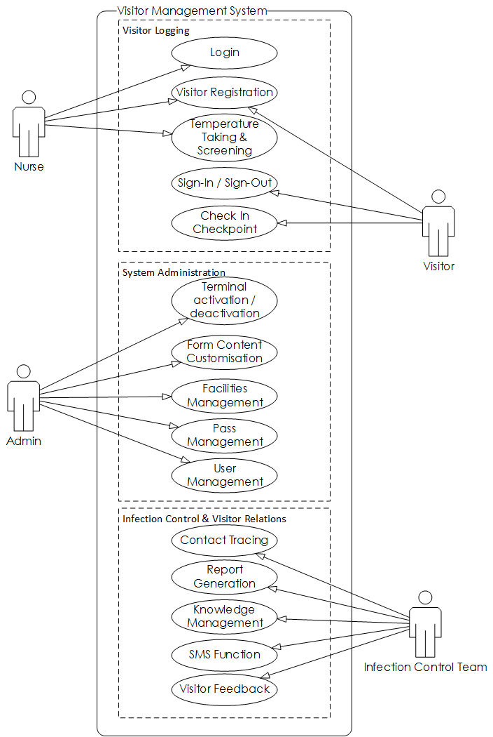
Use Case
Notes:
Nurse & Visitor: Logging & tracking procedures
Infection control team: Reports and knowledge. Overlook process
Admin: customise system

Slide 18
Project Plan

Slide 19
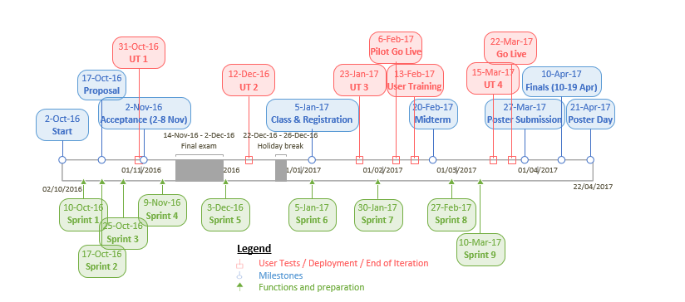
Timeline
Notes:
School milestones
User interaction – UT, training, go live
Total 9 sprints

Slide 20
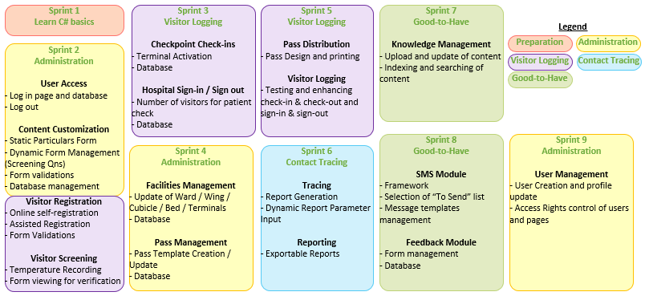
Timeline
Notes:
Timeline, according to colour code on project scope slide. (Core, management and customization functions)
More compact at the front (acceptance and end of year). Next year focused on testing, debugging and enhancements
Sprints of 2-4 weeks.
2 week sprints really a sprint to churn out development
4 week sprints used to enhance and test
Update on the progress later

Slide 21
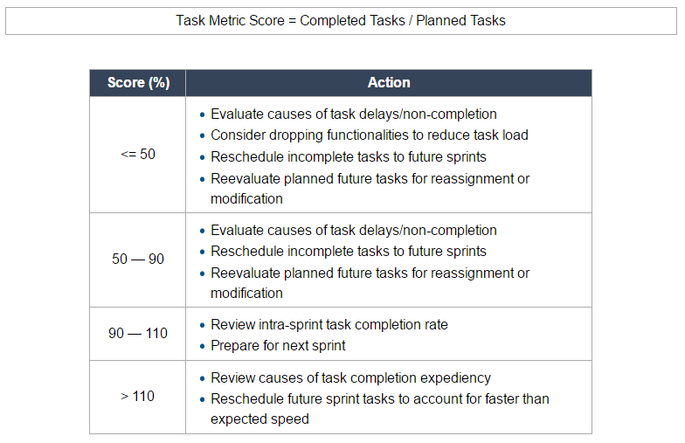
Task Metric

Slide 22
Review of progress based on Task Metric
Sprint # | Completed Tasks | Planned Tasks | TM Score | Action | Status
1 | 1 | 1 | 1.0 | Project on track, prepare for next sprint | Completed
2 | 8 | 11 | 0.72 | Form validations rescheduled to Sprint 3 Online self-registration rescheduled to Sprint 4 Dynamic form management rescheduled to Sprint 5 | Completed
3 | 4+ | 5 | 0.8+ | Project on track, prepare for next sprint | In Progress
4 | - | 5 | - | - | Upcoming
Notes:
Now sprint 3
Sprint 2: 1st development sprint. is 1 week duration
Intentionally push to test our team’s limit
Spread out 3 of the tasks. Not that they have not been started. Already in development

Slide 23
Demo
http://stepwise-is480.azurewebsites.net
Notes:
Development design thought process

Slide 24
User Test Outcomes
Venue: AMK-THKH Hospital Lobby Date: 31st October 2016 Duration: 0930 am – 1130 am User: Mr Edy Chandra, System Analyst
Objectives
To identify any bugs that might affect the application.
To gather user’s feedback on the UI developed.
To detect any usability challenges based on user’s behaviour.
Scope of UT1
Visitor assisted registration (accessible by staff only)
Login
Assisted Registration Process
Visitor Screening and Temperature Taking
Visitor Sign-in & Check-in at terminals
Admin terminal set up

Slide 25
User Test Outcomes
Feedback
System design is aligned with process flow.
Generic
User-friendliness
Business Logic Validation
Amount of data to display
Technical
Security
Code Reusability
Cross-platform support
Notes:
System design aligns with process flow. Right track
Generic
User Friendliness – Autofill of fields (date) to reduce work by user
BL Validation – limit of 3 visitor per customer
Amount of data to display – error messages don’t include specific details such as “Wrong ward John, proceed to ward 3” as it is public system
Technical
Security – database connection encryption
Usability – put code into library eg. Password encryption
Cross-platform support – Xamarim library (dotnet core) to test apps on iphone and android environment

Slide 26
X-factor
To register and track 100 visitors over the 2 hour triage exercise
To be able to track the ward(s) of visit of at least 80% of the visitors who have registered and signed in to the Visitor Management System
Notes:
Triage Exercise which simulates MOH alert level RED.
2 hours on that day - minimise disruption to the visitors and staff.
They are concerned with straining their resources as staff will be required to take up additional responsibilities during a Triage Exercise.
We will be conducting a stress test during the 1-2 hours of the Triage Exercise which can test the robustness of the system. We can also pose as visitors and physically do multiple registrations during that time.

Slide 27
Top 3 Risks
Risk | Mitigation
New language and framework: C#,ASP.NET | Dedicated first iteration to learning C#, ASP.NET Members with experience guiding the rest Splitting up of functions to be coded to smaller, more manageable pieces for individual members
Restriction against testing development application with real patient data due to privacy | Obtain access to an anonymized or mocked-up data version of the Patient Management System instead of the live version Status: Approved by MIS, we will be granted access to a mock-up version of the PMS on a partition of their server
Lack of confirmation about the physical infrastructure to be used to track visitors | Proposals for 3 different possible implementations were submitted for consideration, of increasing physical infrastructure requirements. MIS has requested a scalable solution, starting from basic registration and sign-in, scaling up to check-ins using barcode scanners
Notes:
Point 3: Important feature of our application as well. Let the organization determine what scale they want. Infrastructure will be able to support
Basic / tracking
Other ways of tracking which will be covered later

Slide 28
Limitations
Limitation | Reason for Limitation
Still dependent on staff involvement at registration, though minimal | Staff required to assist for visitors who do not know how to use a computer. Staff required to take temperature and verify the user’s form answering accuracy.
System based on trust of user | Purpose of the system is not for access control.
Notes:
#1 Verifications purpose. Which is already higher level than their tasks in previous process. Focus on watching for people who might show symptoms.
#2 Flexibility to set up and dismantle means relying less on infrastructure or hardware, but more on layout and ‘funneling’ of people. Also a test of whether instructions are clear at the terminal.

Slide 29
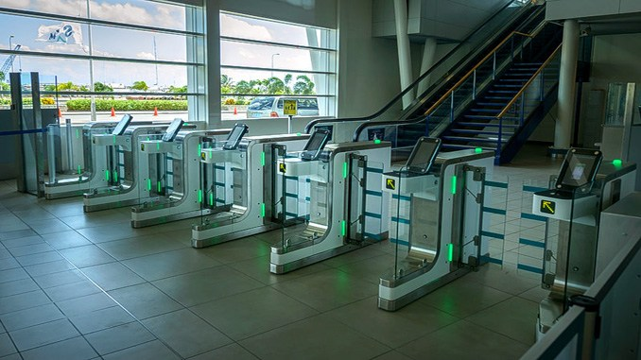
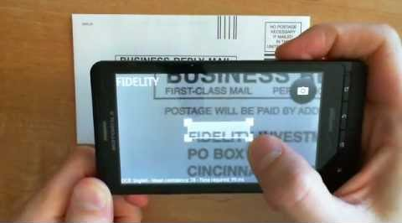
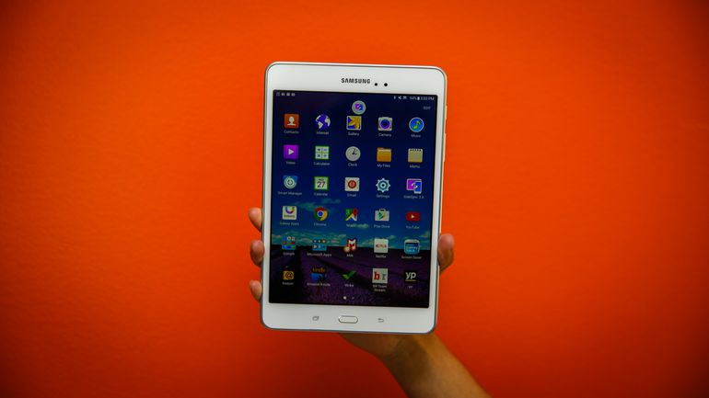
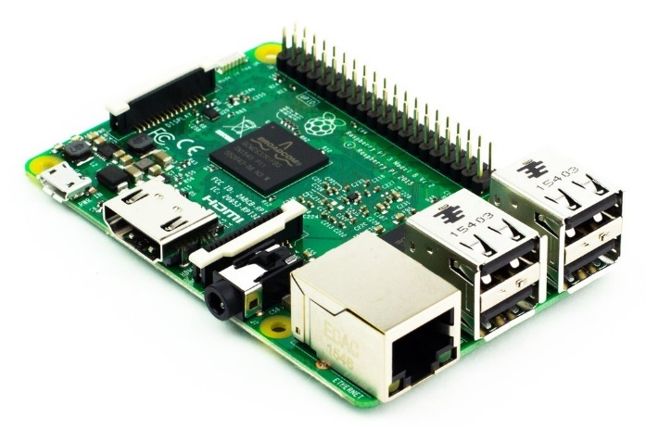
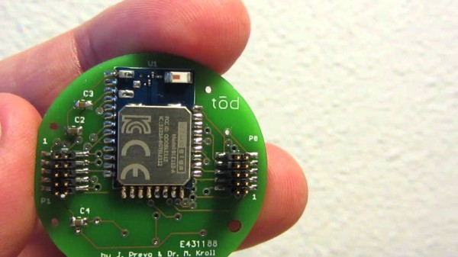
Future possibilities
Live experiment
OCR
Raspberry Pi 3
Tablet
Bluetooth Beacon
Notes:
Live experiment of how many people actually scan, demographics
Which terminal receive the most response. Learn reasons and implement into other terminals
OCR for NRIC fields verification
Tablet for counters & checkpoints
Raspberry Pi 3 to replace physical laptops (price). Just connect scanner -> scalability
OR to do passive tracking with Bluetooth beacons.
Good for other implementations such as tagging of dementia patients or assets (COW, medicine cart) within hospital

Slide 30
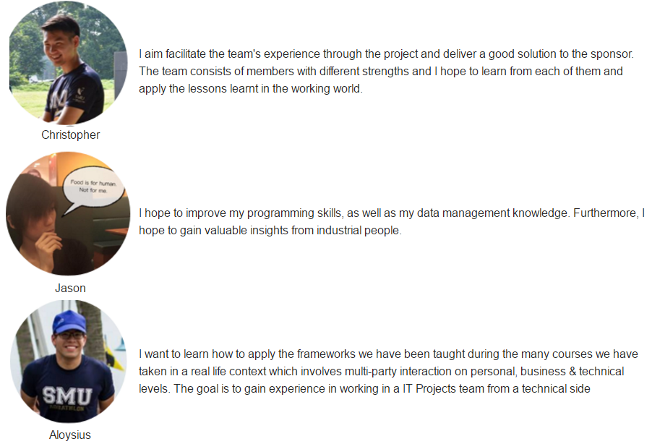
Learning Outcome

Slide 31

Learning Outcome

Slide 32
Thank You

